Slide 1
Power Platform Solution Architect PL-600 Power Virtual Agents
Author name Date
Notes:
Overview of Power Virtual Agents and the role of the solution architect in determining the use for chatbots in the solution.

Slide 2
Agenda
Discuss options for chatbots
Review key concepts and considerations for deploying Power Virtual Agents
Integrating Power Virtual Agents with other services
Power Virtual Agents in Microsoft Teams
Notes:
Chatbots are becoming an increasingly important component of business applications. Understanding the capabilities of Power Virtual Agents is required when designing a Power Platform solution.
This module is concerned with Power Virtual Agents and its capabilities.
In this module, you will:
- Explore options for chatbots and how to choose where to start.
- Explore scenarios for chatbots.
- Understand the components of Power Virtual Agents.

Slide 3

Introduction to Power Virtual Agents
Notes:
What are Power Virtual Agents and the use cases for chatbots

Slide 4

What are chatbots and where are they used?
Classroom discussion
Notes:
Ask for examples where the students have used chatbots
Ask for examples where the students have created chatbots
Discuss how chatbots have a conversation
Prompt discussion on how the language is understood and turned into actions

Slide 5
Characteristics of chatbots
AI powered agents
Multiple channels
Use conversational AI
Web
Language understanding
SMS
First line response to customers
Social media
Handle common enquiries
Telephone
Notes:
We now use multiple communications channels such as email, webchat, telephone, and social media platforms such as Slack, Teams, and Facebook.
Organizations need to be able to contactable by their customers over these multiple channels and further they need to respond consistently in the same manner no matter which channel a customer decides to use.
Users and customers are becoming more demanding, they require 24x7 response, responses that are tailored to their behaviors and characteristics, and to respond to more and more complex requests.
Conversational AI is the use of AI powered agents, known as chatbots, to respond to human questions and requests in an intelligent way. Organizations use chatbots to provide the first line of response to customers, handling common enquiries across multiple channels. Chatbots instigate a conversational dialog with the human whether that is over the web or another channel such as the SMS text service.

Slide 6
Issues building chatbots
Organizations have complex challenges dealing with employees and customers
Self-service
66% of customers try to use self-service first before contacting an agent
Expectations
90% of customers expect consistency across channels
Systems
59% of channels are managed in silos
Notes:
Organizations are going through complex challenges dealing with both employees and customers. Here are some statistics:
- 66% of customers try to use self-service first before contacting an agent. Why? Because contacting an agent takes a long time, you end up in a queue, when you just want an answer straight away.
- 90% of customers expect consistency across channels – on the phone, website, retail store – they want the same treatment.
- 59% of channels are managed in silos; call centers have different incentives than retail stores, the website is managed separately, and so on.
Chatbots can help address all these challenges, but chatbots can be hard to create and expensive to maintain. Traditionally, it takes a lot of skill and effort to create a chatbot, you need developers to code the chatbot, Subject Matter Experts (SMEs) to define the conversational flow, AI specialists to handle the language processing, and the chatbot needs to be able to connect to your back-office systems to access relevant data.

Slide 7
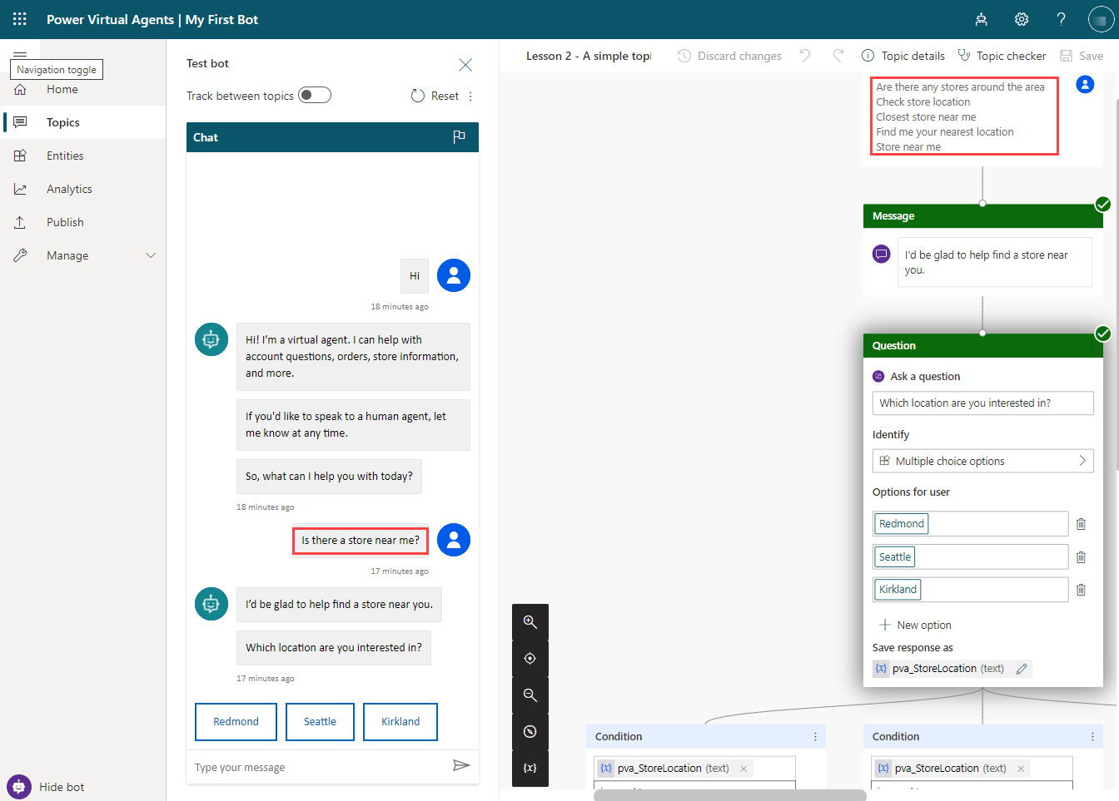
Power Virtual Agents
Power Platform chatbots
Easily create and maintain bots with a no-code interface
Conversational AI experiences based on the Microsoft Bot Framework
Natural language processing
Integrate using Power Automate
Notes:
Power Virtual Agents is designed to create chatbots whether the user is external (your customers) or internal (your employees). SMEs can build conversational flows using an easy graphical interface, with no code, in a browser. Developers and administrators can assist SMEs in building conversational flows and integrating chatbots with line of business applications, using Power Automate cloud flows. Power Virtual Agents include AI language processing to create natural, conversational AI.
Power Virtual Agents make it possible for anyone to build a chatbot and greatly reducing the time and cost involved in deploying a chatbot.

Slide 8
Use cases for chatbots
Conversational AI can be added into application to increase the user experience
Answering questions or enquiries
Process return and exchange requests
Resolving a complaint
Making a reservation or purchase
Manage email subscription preferences
Paying a bill
Triage for healthcare
Notes:
Conversational AI can be added into application to increase the user experience. Here are some common uses for external chatbots:
- Answering questions or enquiries
- Process return and exchange requests
- Resolving a complaint or problem
- Making a purchase / check inventory / make recommendation / track shipping
- Product onboarding / help desk
- Making a reservation / booking a ticket to an event
- Manage email subscription preferences
- Paying a bill / processing a claim
- Finding a qualified person (e.g. professional services)
- Triage for healthcare / crisis communication
- Customer feedback / quizzes, surveys and competitions
A popular use for chatbots is in customer support scenarios. For example, if you visit the HP support site <https://support.hp.com> a chatbot will assist you with troubleshooting, warranty, and repairs.

Slide 9
Use cases for chatbots
Potentially more powerful use cases for using chatbots inside of an organization
Employee onboarding
HR support
Sales support
Issue management
Inspections
Employee ideas
Notes:
Most people's experience of chatbots in in customer support scenarios, but there are potentially more powerful use cases for using chatbots inside of an organization such as:
- HR support
- Employee onboarding
- Employee ideas
- Change management
- IT support
- Sales support
- Case management
- Issue management
- Inspections
- Internal process information

Slide 10

What are the solution architect’s role?
Classroom discussion
Notes:
Ask What should the solution architect consider for using chatbots to solve - be creative!
What should the solution architect ensure that the team follows?

Slide 11
Role of the solution architect
Consider where chatbots can be used to replace other app and user interface experiences
Determine the channels where the chatbot will be deployed
Ensure that the project team follows the principles and best practices for building chatbots
Follow the principles for responsible AI
Notes:
A solution architect should consider using chatbots as part of the solution:
- Consider chatbots to replace web forms, including lead generation forms and enquiry forms.
- Consider a chatbot to help customers navigate and find a person or information, instead of using a website search.
- Chatbots can be used to redirect enquiries to the right person in the organization – customer service agents or professional services staff.
Chatbots are not just for websites. Power Virtual Agents can also be easily deployed to:
- Facebook
- Slack
- Twilio
- Email
- Mobile apps
If the solution architect does decide to use chatbots, the solution architect will need to ensure that the project team follows the principles and best practices for building chatbots as discussed in the remainder of this module.

Slide 12
Responsible AI
Six principles
Fairness
AI systems should treat people fairly
Reliability & Safety
AI systems should perform reliably and safely
Privacy & Security
AI systems should be secure and respect privacy
Inclusiveness
AI systems should empower everyone
Transparency
AI systems should be understandable
Accountability
People should be accountable for AI systems
Notes:
Microsoft has defined six principles for the responsible use of AI. As chatbots are AI based services, the solution architect need to keep these in mind when designing chatbots. The Transparency principle is one of the principles that particularly applies to chatbots.
The Transparency principle is concerned with ensuring that the human understands that they are interacting with a chatbot. When a chatbot conversation is started, the chatbot should clearly state that it is a chatbot. The chatbot should state its purpose and limitations for instance by listing out what the scope of what the bot can answer or do. A chatbot should enable the user to escalate or transfer to a human.
https://www.microsoft.com/ai/responsible-ai
Chatbots work well when they are limited solely to their purpose and do not try to be too generic.

Slide 13
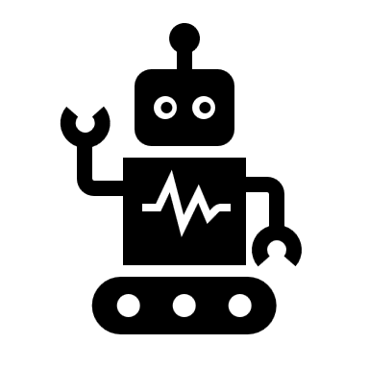
Options for chatbots
Notes:
Discuss the Microsoft options for chatbots

Slide 14
Chatbot options
Microsoft has different options for chatbots
Azure Bot Framework
Azure Bot Composer
Power Virtual Agents
Notes:
Microsoft provides many options for building chatbots:
- Azure Bot Framework
- Azure Bot Composer
- Power Virtual Agents

Slide 15
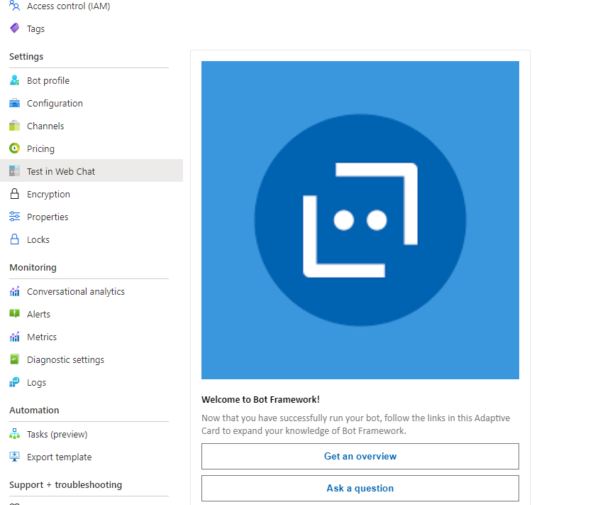
Azure Bot Framework
SDKs and Tools for building and deploying bots
Development
Code based development of bots that can integrate with Azure Cognitive Services and other applications.
Deployment
Deploy to multiple channels without changing code.
Notes:
The Azure Bot Service is part of the Azure Bot Framework, a series of SDKs and tools that allow developers to create and deploy custom bots and virtual assistants using code. The Azure Bot Service is a managed service for developing bots.
A bot communicates by receiving messages and sending responses using an Azure Web App to handle the communications. Bots are like web applications; they take requests and return responses. A bot can perform operations like other applications, they can access databases, call APIs to other services, read files, and perform calculations.
The process of receiving a message and sending a response back to the user is known as a "turn". Think how conversations between humans’ work, each person speaks one at a time i.e., in turn. Bots operate the same way, responding to user input in turn.
A developer can connect an Azure Bot Service bot with the Language Understanding Cognitive Service (LUIS) to add language understanding to a bot to allow for a conversational experience. A developer can also enable their bot to use a knowledge base created in QnA Maker.
An advantage of the Azure Bot Service is that once developers have built bot, the bot can be deployed to one or more channels, such as Facebook or Slack, without having to change the bot’s code. The Azure Bot Service takes care of the communication between these channels and your bots. The Azure Bot Service adapts the messages your bot generates to the format of the channel it is connected to.
Bots created with the Azure Bot Framework can be integrated with Power Virtual Agent bots.

Slide 16
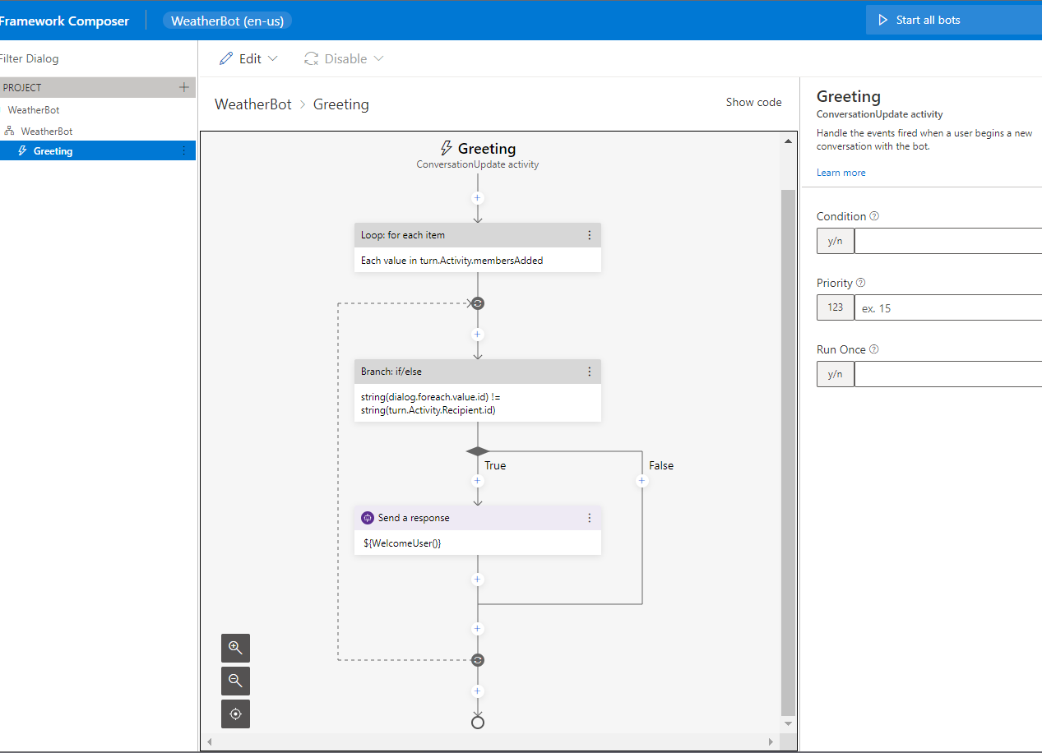
Azure Bot Composer
Visual editing canvas for conversation flows
Tools to author and manage language understanding and QnA
Powerful language generation and templating system
Ready-to-use bot runtime executable
Notes:
The Bot Framework Composer is a tool to build bots. The Bot Framework Composer uses a visual user interface to create the conversational flow and generate responses. Composer is a recent addition to Azure Bot Services and is the subject of ongoing development to add further features. Bot Framework Composer includes:
- A visual editing canvas for conversation flows
- Tools to author and manage language understanding (NLU) and QnA components
- Powerful language generation and templating system
- A ready-to-use bot runtime executable
Bot Framework Composer can be used to build bots without the need to write code and supports both LUIS and QnA Maker.
There are similarities between Power Virtual Agents and Composer; both provide a no-code authoring canvas for users to build bots. However, there are key differences in the functionality and look of both technologies. For instance, topics in Power Virtual Agents are similar to dialogs in Composer.
The Bot Framework Composer is open source and is multi-platform with support for Windows, Linux, and MacOS.
Bot makers can use Bot Framework Composer to create custom content and add it to Power Virtual Agents.

Slide 17
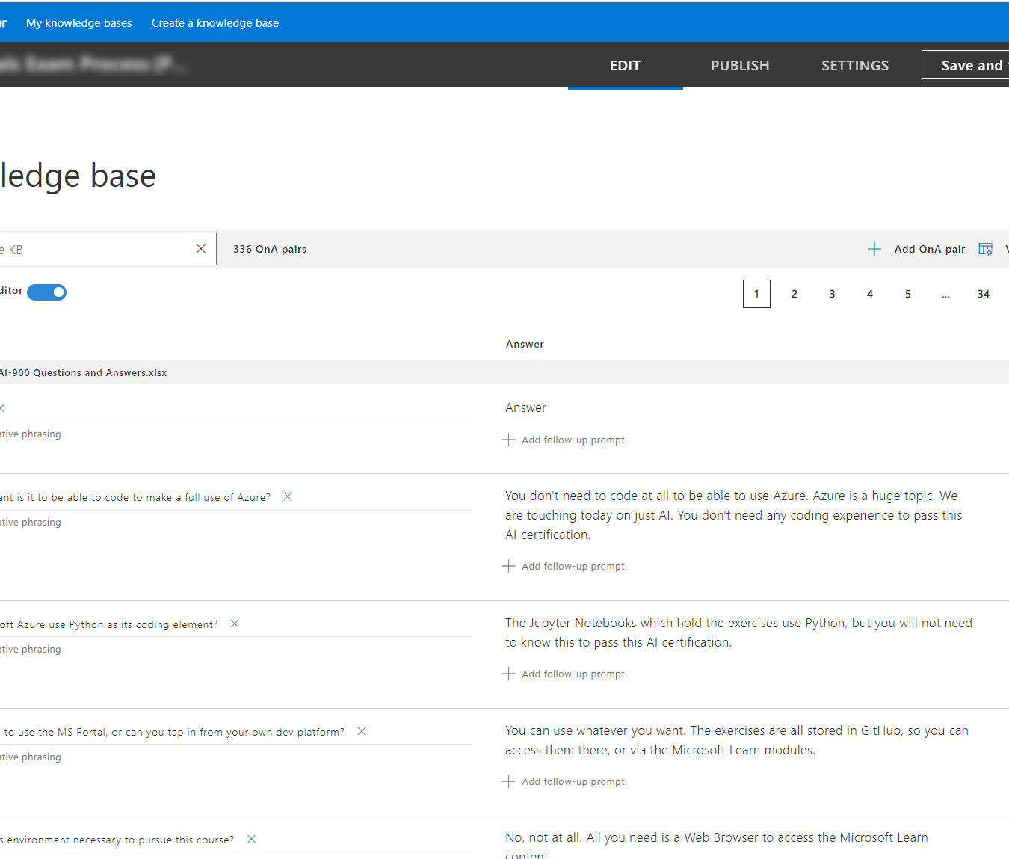
QnA Maker
Knowledge bases
Build
Extract information from existing documents and websites to create knowledge bases. Natural language processing is included.
Use with bots
Create a bot from the knowledgebase or integrate the knowledge base with an existing bot.
Notes:
QnA Maker is a service that creates a searchable knowledge base from existing documents and websites. This knowledge base contains built in natural language processing. The QnA Maker knowledge base can then be used in bots and other applications to respond to FAQ type questions.
QnA Maker does not provide a bot itself, but you can easily generate an Azure Bot Service bot from your QnA Maker knowledge base in a few minutes without writing any code.
A knowledge base consists of question-and-answer pairs. You can create the questions and answers in a number of different ways:
- Extraction from existing documents.
- Extraction from web pages.
- Manual input.
QnA Maker knowledge bases can be integrated with Power Virtual Agent bots with Power Automate.

Slide 18
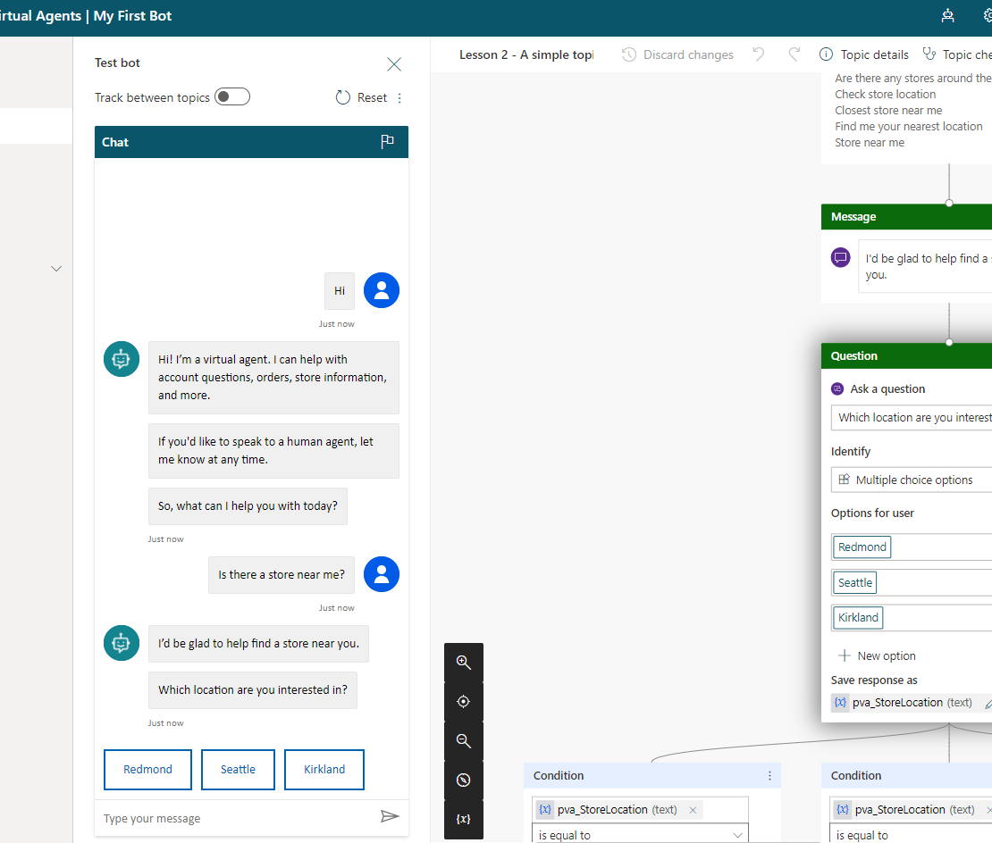
Power Virtual Agents
Low code chatbots
Build
Build chatbots along side Subject Matter Experts with no requirement for developers or data scientists
Deploy
Easily deploy to same channels as Azure Bot Framework
Notes:
Power Virtual Agents chatbots are chatbots powered by artificial intelligence (AI) that allow users to focus on more complex and higher-value work while the chatbots themselves handle simple repetitive interactions. With Power Virtual Agents, you can create chatbots using an easy to use, no-code graphical interface from within a web browser.
Power Virtual Agents chatbots interact with customers and employees, answer questions, and provide information. You can deploy Power Virtual Agents chatbots to multiple channels, including your own website, Facebook, and Microsoft Teams.
Power Virtual Agents chatbots can be created easily without the need for data scientists or developers.
Power Virtual Agents is built on top of the Azure Bot Framework and leverages the capabilities of the Bot Framework in a no-code environment.
Power Virtual Agents can meet many simple requirements for chatbots, both internal and external. Power Virtual Agents are designed to be built with, or by, Subject Matter Experts (SMEs).
Power Virtual Agents are licensed per tenant and are charged based on the number of billed sessions per tenant per month. There is an initial entitlement of 2,000 sessions and additional capacity can be purchased
The solution architect needs to determine which bot technology, or combination of technologies to use in the solution. This will depend on the skills available, if there are existing bots already deployed, and the complexity of the bots required.

Slide 19

Concepts
Notes:
When creating chatbots there are some import concepts to understand before building your chatbot.

Slide 20
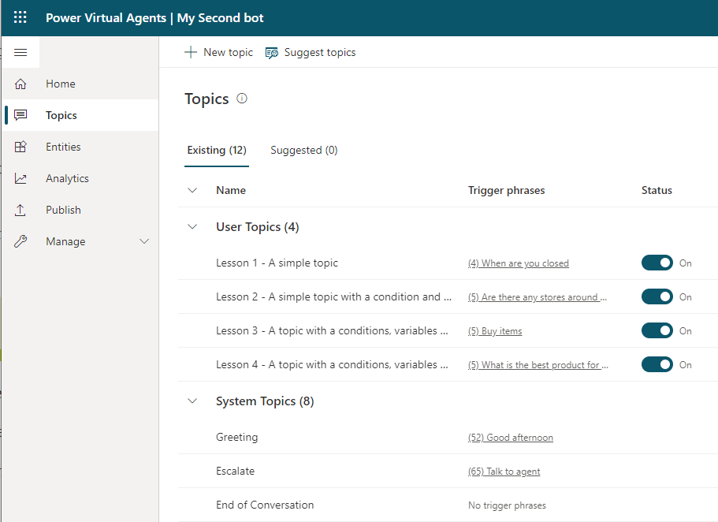
Topics
Conversation paths
Conversations
Trigger phrases
Conversation nodes
Uses natural language understanding (NLU) model
Notes:
Power Virtual Agents work by identifying the subject that the user is asking about and then having a conversation about that subject.
Topics are the main subjects of the conversation. A Power Virtual Agents chatbot can have up to 1,000 topics. Each topic is a separate conversation path. It is the combination of topics in a chatbot that provides a natural conversational flow. You create topics for the tasks or requests that you need your chatbot to respond to.
Topics define the purpose of your chatbot and are the first step in authoring your chatbot. A topic has two parts:
- Trigger phrases: The keywords, phrases, or utterances that the user will enter
- Conversation nodes: How your bot should respond
Each topic has its own conversation flow with the bot. When a bot identifies a trigger for a topic, the conversation for that bot is initiated.
The use of the natural language understanding (NLU) model means that in Power Virtual Agents, when you craft trigger phrases for a topic, you only need to provide a few examples, usually in the range of five to ten phrases for a single topic. Shorter trigger phrases are better, and you should aim for two to ten words. You just need to make sure trigger phrases are semantically different: changing a single verb or noun could be enough to expand a topic's coverage. Adding things like new articles (changing or adding 'the' or 'a' or 'an'), changing capitalization, adding contractions (you're or don't), or adding plurals won't improve the triggering because contractions are already accounted for in the natural language understanding model.
Many organizations will have procedures, product information, frequently asked questions, and other information in documents or on websites. Power Virtual Agents can extract information and create topics with trigger phrases using the Suggest topics option.
If you are using Dynamics 365 Customer Service Insights, you can select the topics from within Customer Service Insights and add the topics and trigger phrases to your Power Virtual Agent chatbot.

Slide 21
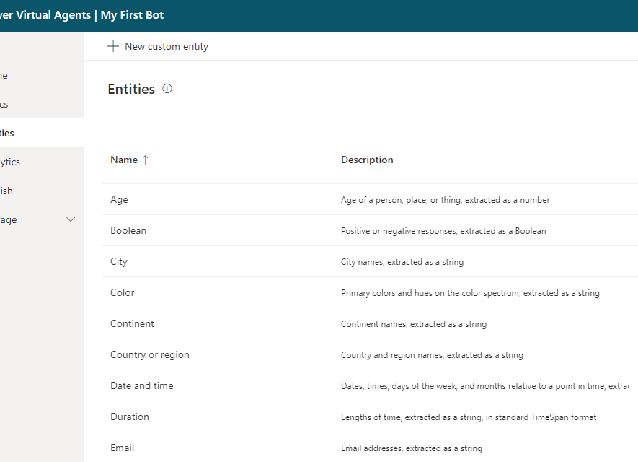
Entities
Extract information
Help identify what the user is asking about
Control conversation path
Pre-built entities
Custom entities
Notes:
Power Virtual Agents attempts to extract information from the phrases entered by the user. This extracted information can be used to control the conversation's path. Power Virtual Agents uses entities to identify information in a textual phrase, for instance, names, dates, and numbers. Your chatbot can then use this information to decide on the appropriate next step in the conversation.
Entities are people, places, and things that a chatbot can identify from the phrases entered into a chatbot. Power Virtual Agents includes a set of pre-built entities for the most commonly used objects and you can create custom entities for the domain of the business solution you are building.

Slide 22
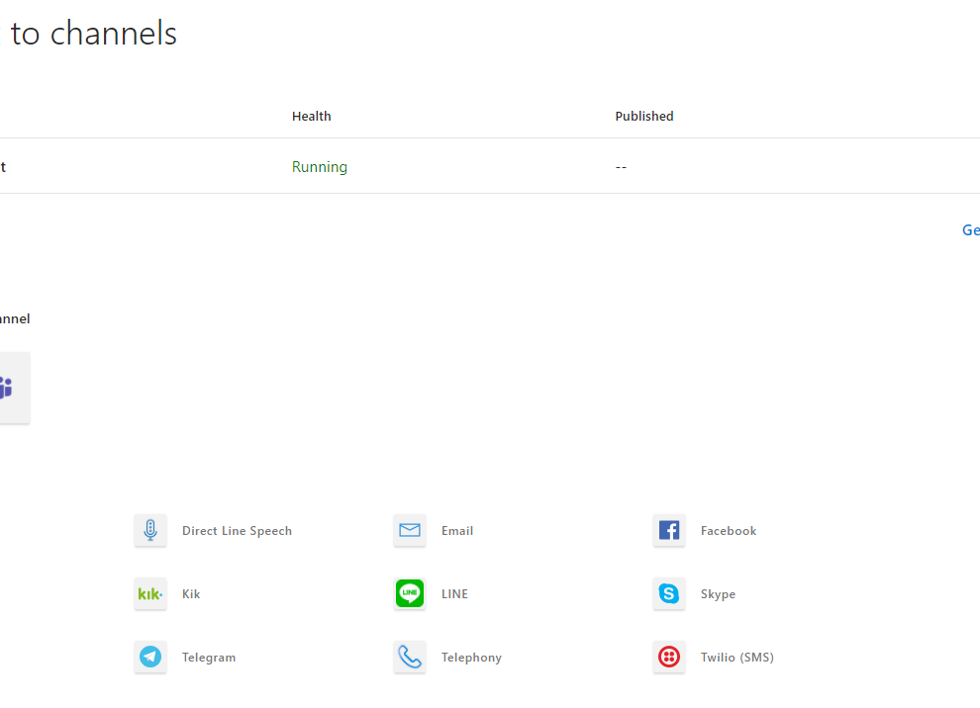
Channels
Distribute chatbots
Provided by Azure Bot Framework
Automatically adjust format to the channel’s service
Web only by default
Notes:
The Azure Bot Framework separates the logic of the bot from the communication with different services. When you create a bot, the bot is only available for use embedded on websites with the Web Chat channel. You can add channels to your bot to make the bot available on other platforms and services, known as channels.
One of the major benefits of the Azure Bot service is that you develop your bot once and connect to multiple channels without needing to change the code for each channel to handle the specific requirements and formats of that channel. The Azure Bot Service takes care of those requirements and converting the formats.
The following channels are available for connection to bots:
- Alexa
- Direct Line
- Direct Line Speech
- Email
- Facebook
- GroupMe
- Kik
- Line
- Microsoft Teams
- Skype
- Slack
- Telegram
- Telephone
- Twilio (SMS)
- Web Chat
Power Virtual Agents can be deployed to the same channels.

Slide 23

Best practice
Notes:
Best practice and considerations for deploying Power Virtual Agents
Chatbots, if used, are a very powerful tool for increasing customer interaction with your solution. A solution architect must ensure that the chatbots are correctly built and meet the requirements.
This section contains recommendations around designing and deploying chatbots.

Slide 24
Planning
Define the scope of the chatbot
Define the purpose of the chatbot
Define the channels for the bot
Define key metrics and success criteria
Verify topics and entities
Notes:
When planning a chatbot the solution architect should:
- Define the scope of the chatbot
- Define the purpose of the chatbot
- Define which channels the bot will be deployed to
- Define the key metrics and success criteria
- Verify the topics, entities, and conversational flows.
A chatbot supports three different types of topic:
- Informational
- Tasks
- Troubleshooting
A good Power Virtual Agents chatbot will have a high business impact i.e., a high level of traffic, a low level of integration complexity, and will achieve a high level of conversation completion without the need for escalation to a human agent.
A well designed chatbot will have a well defined set of goals. Each topic is linked to a business process and has trigger events, a clear set of rules, a set of documents, and a series of tasks that will be performed.
The solution architect may need to provide guidelines for creating topics and trigger phrases for chatbot authors to follow.

Slide 25
Escalations
Hand off conversations to live agents seamlessly and contextually
Requires an engagement hub
Solution architect determines when escalation should occur and how escalation will be handled
Notes:
With Power Virtual Agents, you can hand off conversations to live agents seamlessly and contextually.
When you hand off a conversation, you share the full history of the conversation (the context) as well as all user-defined variables. Having access to this context means live agents that are using any connected engagement hub can be notified that a conversation requires a live agent, see the context of the prior conversation, and resume the conversation.
You need to have an engagement hub that is being used by live agents, such as Omnichannel for Customer Service, and you need to configure the connection.
The solution architect should determine when escalation should occur and how escalation will be handled.
Power Virtual Agents chatbots come with telemetry built-in so that you can monitor how your chatbots are being used. Key KPIs are the rates of abandonment and escalation to a human agent. You should monitor your chatbots and change your chatbot to increase its effectiveness.

Slide 26
Variables
Save responses and reuse in conversation
Pass to Power Automate flow
Topic or Bot variables
Notes:
Variables let you save responses from your users in a conversation so that you can reuse them later in conversations.
The response for each question asked in a conversation is stored as a variable. You can then pass the variable to a Power Automate flow or use the variable later in the topic, or even in other topics, to control the questions being asked. For example, you can use a variable to decide to skip a question if you have the information you need at that point.
Variables can be defined as either of the following:
- Topic: The variable can only be used within its topic.
- Bot: The variables can be used by any topic.
The solution architect should encourage the use of variables by chatbot authors to improve conversational flow.

Slide 27
Authentication
Azure Active Directory
OAuth2
Single sign-on
Notes:
You can enable user authentication directly within a Power Virtual Agents bot conversation. User authentication means you can get a user's basic properties such as name and ID in bot variables, but also prompt a user to sign in using an authentication node, retrieve a user token for that user, and then use that token to retrieve the user's information from a back-end system.
Power Virtual Agents supports the following authentication providers:
- Azure Active Directory.
- Any identity provider that is compliant with the OAuth2 standard e.g., Microsoft Account or Facebook.
Power Virtual Agents supports single sign-on (SSO), which means chatbots can sign the user in if they're in to the page where the bot is deployed. You will need to register the web app in Azure Active Directory to enable SSO.
The solution architect should determine if authentication is required for bots and the identity provider used. In many situations, the organization may already have identity providers configured in Azure Active Directory. If creating chatbots for Microsoft Teams then this is simple to configure with the "Only for Teams" option, however if creating chatbots for customers you may need to consider Azure B2B and Azure B2C for authentication.

Slide 28
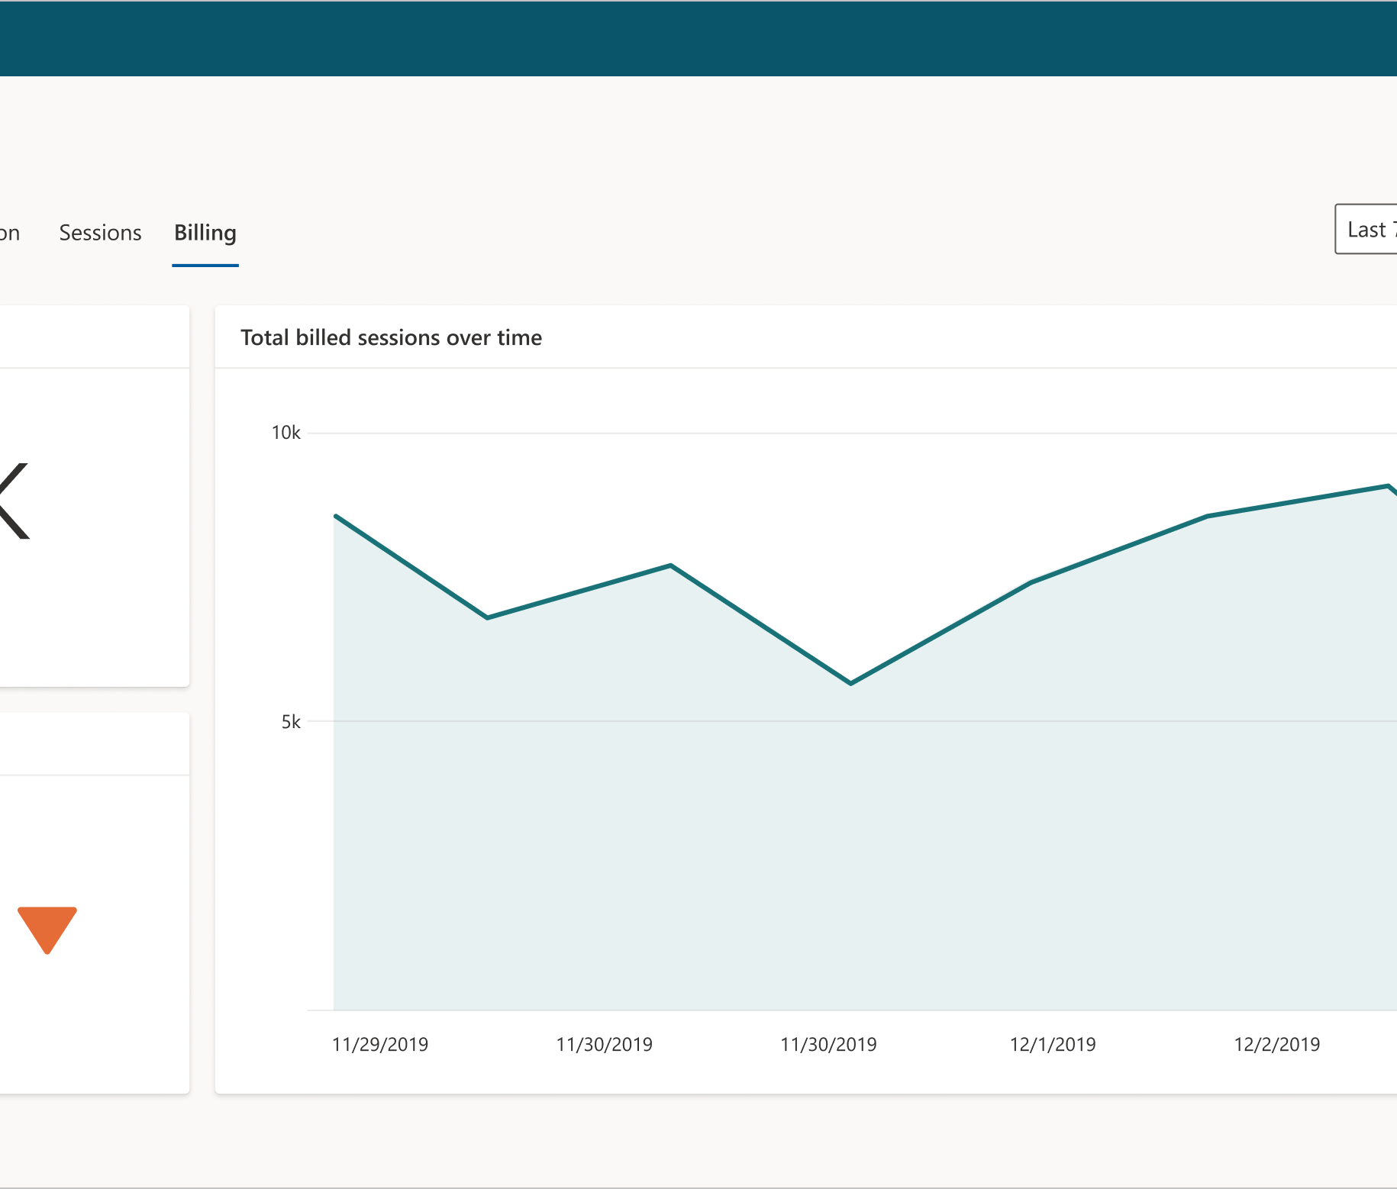
Sessions
Monitor sessions against allowance
Capacity
License includes a number of billed sessions per tenant
Rate limits
Quotas are applied to chatbots to limit how often messages can be sent to the chatbot
Notes:
Capacity
When you purchase a Power Virtual Agents license, you gain capacity for the specified number of billed sessions. Power Virtual Agents pools this capacity across the entire tenant.
You can monitor how many billed sessions have been used from the Analytics tab in the Power Virtual Agents portal.
The solution architect will need to estimate the number of sessions required and ensure that monitoring is implemented to track bot usage and costs.
Rate limits
Quotas are applied to chatbots to limit how often messages can be sent to the chatbot. The purpose of quotas is to throttle the service load and protect the service from being overloaded.
Quotas for Power Virtual Agents chatbots are defined as requests per minute (RPM). A request is a message from the user to the chatbot, or a message from an Azure Bot Framework Skill, in a single chat session.
The Quota is 600 RPM in the North America region and 800 RPM for the rest of the world.

Slide 29
Considerations when deploying Power Virtual Agents
Solutions
Deployment
Power Virtual Agents are solution aware
Use Environment variables
Power Virtual Agents contain many sub-components that must be exported together
Post deployment manual actions required
Consider separate solution for Power Virtual Agents
Include actions in deployment plan
Notes:
Solutions
Power Virtual Agents are solution aware and can be included in solutions and application lifecycle management processes.
Bots contain many sub-components, such as Topics, that must all be exported and imported together. You should consider creating segmenting your solution and have bots and their sub-components separate in a separate solution from other components.
You can only import and export bots with the Power Virtual Agents web app. The feature is not available in the Power Virtual Agents app in Microsoft Teams.
Deployment
Power Virtual Agents are created in a selected environments. You should ensure that you are using the correct environment for development, test, and production purposes when creating chatbots.
If you are using skills, then you need to define environment variables for each skill.
Post deployment of your bot via a solution there are manual tasks that may need to be performed:
- Power Automate cloud flows: Configure any connections for the first time and visit the Power Virtual Agents portal and select the bot.
- Skills: Add the values for the skills’ environment variables.
- End-user authentication: Configure end-user authentication in the bot so it can take actions on the user’s behalf.
- Escalations: Configure external services that hand off bot escalations to a human agent.
- Multichannel: Configure external channels, such as Facebook, and internal non-Power Virtual Agents services, such as Microsoft Teams.
The solution architect should ensure that these steps are included in the deployment plan for the solution.

Slide 30

Integrating Power Virtual Agents
Notes:
This unit is about integrating Power Virtual Agents with other services
Power Virtual Agent chatbots will often require access to other services and systems to be able to complete their goals. Power Virtual Agents can also be integrated with other Microsoft AI services to create an enhanced customer experience.

Slide 31
Integration options
Power Automate
The primary integration method for Power Virtual Agent chatbots.
Use Power Automate to connect to other systems including Dataverse and Azure Cognitive Services.
Skills
Extend bots using Microsoft Bot Framework skills.
Add a Power Virtual Agents chatbot to an existing Azure Bot Framework bot
Use an Azure Bot Framework bot from within a Power Virtual Agent chatbot.
Bot Composer
Use Bot Framework Composer to create custom content and add it to Power Virtual Agents.
QnA Maker
Extend a Power Virtual Agents chatbot to provide answers from a QnA Maker knowledge base.
Add a fallback topic and use Power Automate to connects to a QnA Maker knowledge base.
Notes:
Power Automate
The primary integration for Power Virtual Agent chatbots is through Power Automate cloud flows.
Power Virtual Agents can pass parameters to a Power Automate cloud flow and receive data back from the flow and use that data in the chatbot's conversation flow. For instance, a chatbot may handle customer order updates and so will use a Power Automate cloud flow to fetch the order's status from the relevant system.
Power Automate cloud flows can be initiated from the all an action node in a topic.
Skills
Power Virtual Agents enables you to extend your bot using Microsoft Bot Framework skills. If there are existing Azure Bot Framework bots deployed, you can define those bots as a skill and embed the skill within a Power Virtual Agents bot. You can then use the Azure Bot Framework bot from within your Power Virtual Agent chatbot.
A developer can also use a Power Virtual Agent chatbot from an Azure Bot Framework bot. The Power Virtual Agent becomes the skill and the Microsoft Bot Framework dispatcher tool can integrate with the Power Virtual Agents bot.
The solution architect needs to oversee the design of bots and decide when to leverage existing bots and when to create new bots and with which toolset.
Bot Composer
Bot makers can use Bot Framework Composer to create custom content and add it to Power Virtual Agents.
For instance, by using Composer with your Power Virtual Agents chatbot you can:
- Show an Adaptive card.
- Use Bing Search as a fallback.
QnA Maker
You can extend a Power Virtual Agents chatbot to provide answers from a QnA Maker knowledge base. You need to add a fallback topic that uses Power Automate to run a cloud flow that connects to the QnA Maker via its connectors to respond to questions.
See https://docs.microsoft.com/azure/cognitive-services/qnamaker/tutorials/integrate-with-power-virtual-assistant-fallback-topic for the steps required. Consider demoing this is you have time
Cognitive Services
Azure Cognitive Services can be used by bots for a number of purposes such as:
- Sentiment analysis
- Image classification
- Form recognition
You can use Azure Cognitive Services with Power Virtual Agents using Power Automate cloud flows and the associated Cognitive Services connector.

Slide 32

Power Virtual Agents in Microsoft Teams
Notes:
Power Virtual Agents in Microsoft Teams

Slide 33
Power Virtual Agents
Web app
Standalone
Microsoft Teams
Inside Teams
Internal or external chatbots on all channels
Internal chatbots only inside Microsoft Teams
Created by IT professionals
Created by subject matter experts
Requires additional license
No additional licensing required
Notes:
Power Virtual Agents is available as both a standalone web app, and as a discrete app within Microsoft Teams. Most of the functionality between the two is the same. However, there are different reasons to choose one version or the other based on your requirements.
Power Virtual Agents Web app
You will use standalone Power Virtual Agents if:
- You are an IT administrator or consultant and want to create bots for your customers to engage with.
- You want to create bots for external customers.
- You have used chatbot services in the past and want to trial or test Power Virtual Agents.
- You are familiar with advanced chatbot concepts, such as entities and variables, and want to create complex chatbots.
Power Virtual Agents in Microsoft Teams
You will use Power Virtual Agents in Microsoft Teams if:
- You are an employee or member of an organization or team and want to create chatbots to answer common questions posed by other employees or teammates.
- You want to use advanced concepts, such as entities and variables, but have the chatbot available only internally.
- You want to create and distribute a chatbot in the shortest time possible.
The Power Virtual Agents app in Microsoft Teams supports single sign-on (SSO), which means chatbots can sign the user in silently, without having the user enter their credentials.
Power Virtual Agents in Microsoft Teams does not require additional licensing as the license is included with Microsoft 365 subscriptions.
Access is limited however to the membership of the Microsoft Team that the chatbot is deployed to. The chatbot cannot be deployed to other channels.

Slide 34
Limitations
Integration options limited to standard connectors in Power Automate
10 sessions per user every 24 hours
Notes:
Power Virtual Agents in Microsoft Teams have a number of limitations such as:
- Power Virtual Agents in Microsoft Teams are limited to the standard Power Automate connectors available for flows triggered from Power Virtual Agents.
- Power Virtual Agents in Microsoft Teams can be integrated with Azure Bot Framework skills but require a Power Virtual Agents standalone license.
- Power Virtual Agents in Microsoft Teams cannot integrate Microsoft Bot Framework dialogs and cannot be used with Azure Bot Framework Composer.
- Power Virtual Agents in Microsoft Teams cannot be included in solutions.
Power Virtual Agents in Microsoft Teams are limited to 10 sessions per user every 24 hours.

Slide 35
Group exercise
Evaluate the need for chatbots
Review each scenario and decide how best to address the requirements
Scenario 1
Product and pricing
Scenario 2
Customer service
Notes:
Answers on following slides
Scenario: Product and pricing
The organization has a complex set of products and prices. Sales users find it difficult to find information about which products can be sold together and how to determine the correct pricing.
You have the following set of requirements:
- Sales people must be able to find details about products easily.
- Sales people need to be shown the pricing rules for each product.
- The rules for products and prices vary by country.
What should you use to meet these requirements?
Scenario: Customer service
The customer service department is overwhelmed with calls. You have been tasked with improving productivity of the department and increasing customer satisfaction.
You have the following current systems:
- Dynamics 365 Customer Service is installed for basic ticket management.
- Legacy website that allows customers to login and see their tickets and submit new tickets. New tickets are created in Dynamics 365 but there is no further integration.
- SharePoint library with support processes and other documentation.
You have the following set of requirements:
- The website only shows the basic ticket details that were submitted. Customers must be able to easily obtain the status and latest action for their tickets.
- Customers have requested a search capability for support information on the website.
- Easily answered questions should be handled by a bot.
- Customers should be able to be transferred to a human agent with the bot conversation available to the human agent.
What should you use to meet these requirements?

Slide 36
Scenario 1 Answer
Product and Pricing
Use Power Virtual Agents for Teams
Create a Team for each country
Create a bot for each Team for the rules for that country
Use Power Automate to perform calculations if necessary

Slide 37
Scenario 2 Answer
Customer service
Use Power Virtual Agents web app
Implement Dynamics 365 OmniChannel engagement hub
Create a QnA Maker knowledge base using the information in SharePoint
Integrate QnA Maker using Power Automate
Deploy to web channel

Slide 38
Summary
Power Virtual Agents are a very powerful tool for creating great customer experiences
The solution architect should consider using chatbots as part of the solution
The solution architect will need to ensure that the project team follows the principles and best practices
Notes:
Power Virtual Agents are a very powerful tool for creating great customer experiences. The solution architect should consider using chatbots as part of the solution:
- Replace web forms.
- Help customers find information, instead of using a website search.
- Employee assistance and information retrieval.
If the solution architect does decide to use chatbots, the solution architect will need to ensure that the project team follows the principles and best practices outlined in this module.

Slide 39
Closing slide

Slide 40
References
Responsible AI https://www.microsoft.com/ai/responsible-ai
Power Virtual Agents best practices blog post https://powervirtualagents.microsoft.com/blog/best-practices-when-planning-to-use-chat-bots/osoft.com/en-us/learn/
Power Virtual Agents Create bots with Power Virtual Agents Learning Path https://docs.microsoft.com/learn/paths/work-power-virtual-agents/
Power Virtual Agent Documentation https://docs.microsoft.com/power-virtual-agents/
Notes:
It is good practice to tie back your ILT deliveries to role-based learning materials on Microsoft Learn. What is listed here should supplement your delivery and the role-based training your course is affiliated with. It is important to give the learners continued education opportunities for growth.

